Slide 1

The Extendables
Fin Hume

Slide 2
Agenda
Where did this come from?
What can we do with this?
Does anything already exist?
What new stuff can we do?
Are the blue team aware?
How can I protect myself?
Is there an easy way I can test this?

Slide 3

Why should I listen to you?
I’m Fin
Security Consultant at WithSecure for over 3 years
Finds vulnerabilities in stuff
Look at malware too

Slide 4
1. Where did this come from?

Slide 5

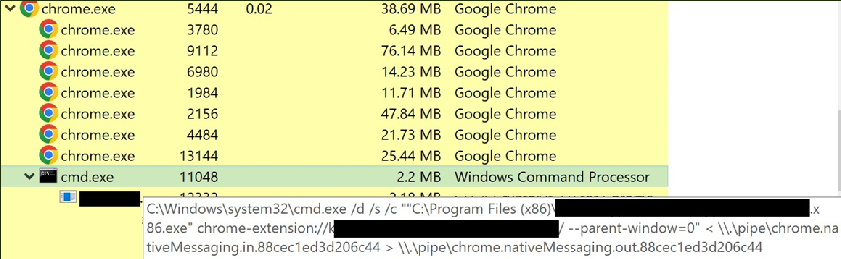
Is it safe?
A client wanted to know if a browser extension was dodgy
So I was tasked find out
I loaded it into a test environment and saw this…

Slide 6




This is a bit sketchy…
Why is chrome spawning CMD and a random EXE?
What are the named pipes for?
This can’t be legit right?
So I got to analysing it further

Slide 7
NativeMessaging
References to "NativeMessaging" in the code
It was also in the commandline earlier
What is "NativeMessaging"?

Slide 8


What does the foxdocs say?
Let’s look at the chrome documentation:
“Extensions and apps can exchange messages with native applications using an API”
“Chrome starts the host in a separate process and communicates with it using standard input and standard output streams”
It is used by applications that need to interact with the browser
Eg. Password managers

Slide 9

What does that look like in practice?
Browser
CMD
Named Pipe
Native messaging host app

Slide 10







How does the browser know?
Extension Manifest
JavaScript to start it all
Browser
Extension
NativeMessagingHost Manifest
NativeMessagingHost Registry Key
Installer
Script

Slide 11
Extension Manifest
{
"name": "The Extendables Extension",
"version": "1.0",
"key":"<REDACTED FOR BREVITY>",
"manifest_version": 3,
"description": "Extension for a proof-of-concept",
"background": {
"service_worker": "service-worker.js"
},
"permissions": [
"nativeMessaging"
]
}

Slide 12
JavaScript to start it all
chrome.runtime.onStartup.addListener(function() {
})
chrome.runtime.connectNative('com.withsecure.theextendables');

Slide 13
NativeMessaging Manifest
{
"name": "com.withsecure.theextendables",
"description": "My Application",
"path": "C:\Windows\System32\calc.exe",
"type": "stdio",
"allowed_origins": ["chrome-extension://<EXTENSION ID>/"]
}

Slide 14
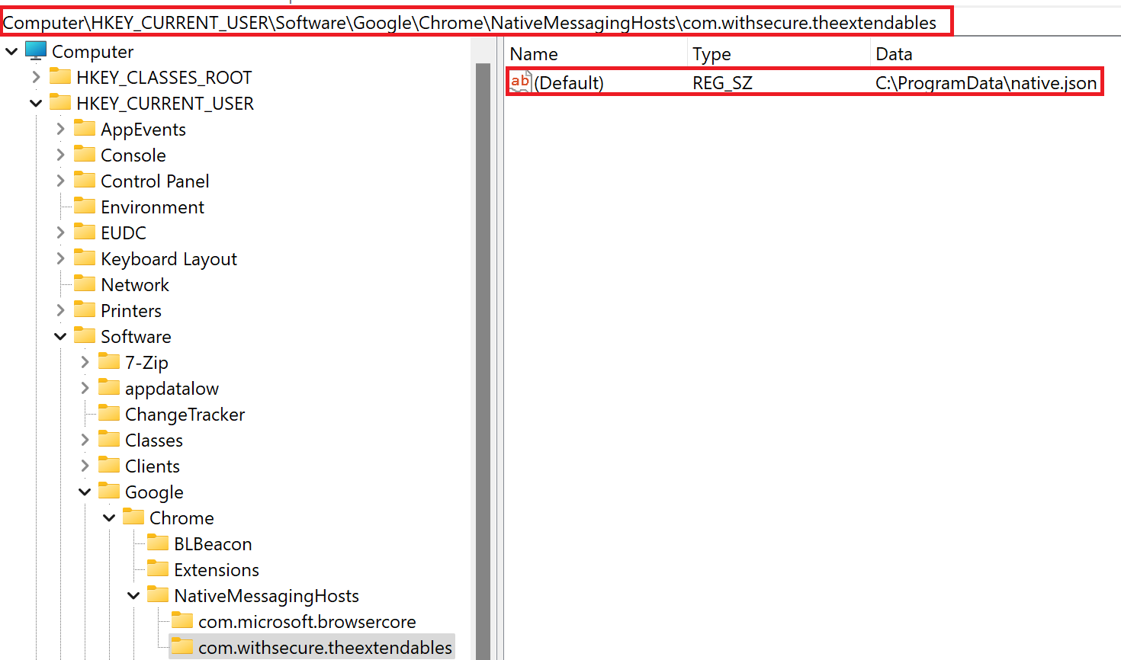
NativeMessaging Host Registry Key
Can go in either HKCU or HKLM

Slide 15
2. What can we do with this?

Slide 16

Persistence!
This seems like a great way to persist!
Starts arbitrary script/exe when browser is opened

Slide 17
3. Does anything already exist?

Slide 18
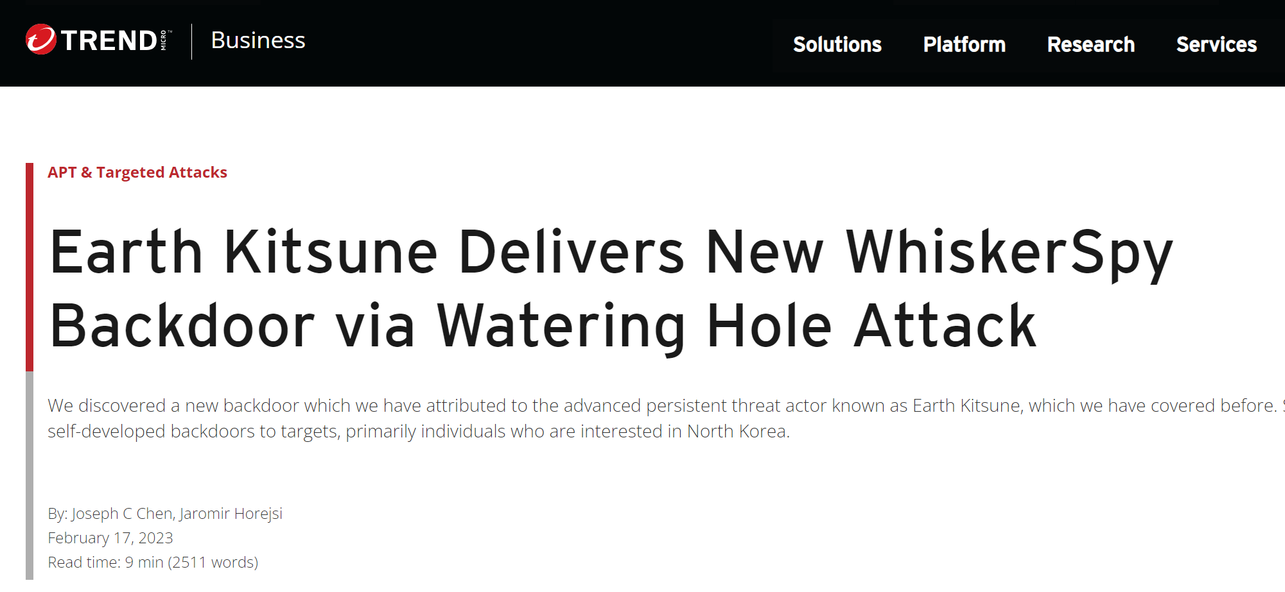
WhiskerSpy
I searched far and wide to find if this was new
I saw nothing!
Until a colleague pointed out:

Slide 19

WhiskerSpy
Credit to Joseph Chen and Jaromir Horejsi of Trend Micro
To summarise, one version of WhiskerSpy:
Uses an installer to install the required files
Does C2 via the NativeMessaging
Runs on startup like we suggested earlier

Slide 20
4. What new stuff can we do?

Slide 21
What else can we do?
My research and WhiskerSpy left me thinking:
Does anything else use NativeMessaging?
What other ways could we deliver this?
Does this functionality expose any other attack surface?

Slide 22
I. Does anything else use NativeMessaging?

Slide 23




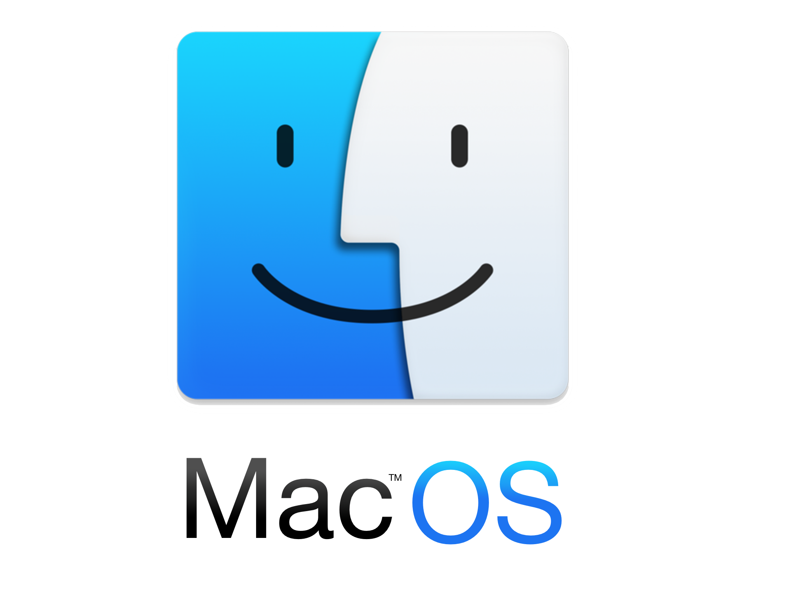
Does anything else use NativeMessaging?
Yes, most browsers:
Chrome
Edge
FireFox
Also works on all major OS’:
Windows
Linux
MacOS

Slide 24
II. What other ways could we deliver this?

Slide 25

What other ways could we deliver this?
Our research’s delivery was very manual
WhiskerSpy used an installer

Slide 26

What options did I come up with?
Force download through the registry
Backdoor existing shortcut files
Enumerate installed extensions

Slide 27
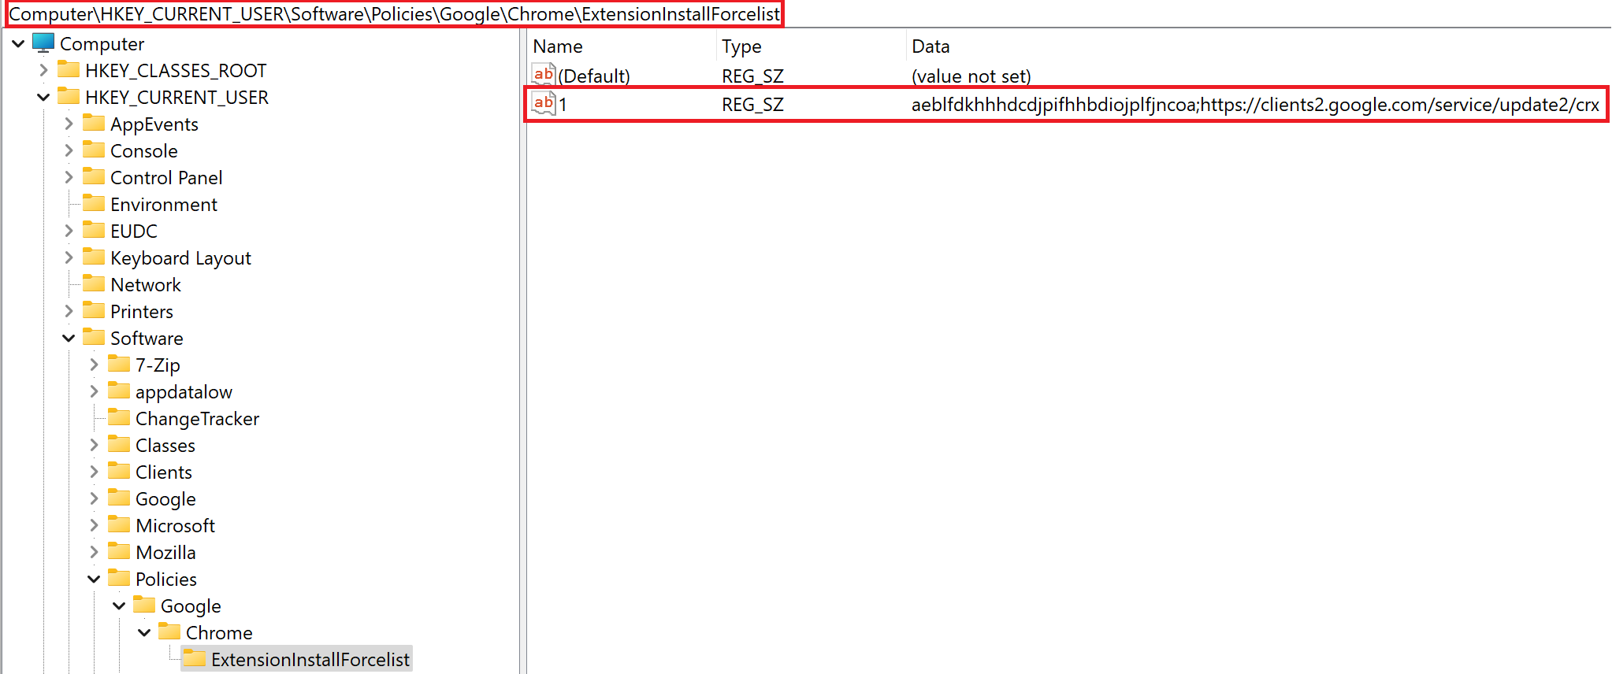
Force download through the registry
You can do this for both the current user and the machine
No user interaction is required
Gets around group policy
Can be used to run code as another user
Software\Policies\Google\Chrome\ExtensionInstallForcelist
Software\Policies\Microsoft\Edge\ExtensionInstallForcelist
(Edge can also download chrome extensions)
Requires admin for both HKCU and HKLM
Only works on Chromium-based browsers

Slide 28
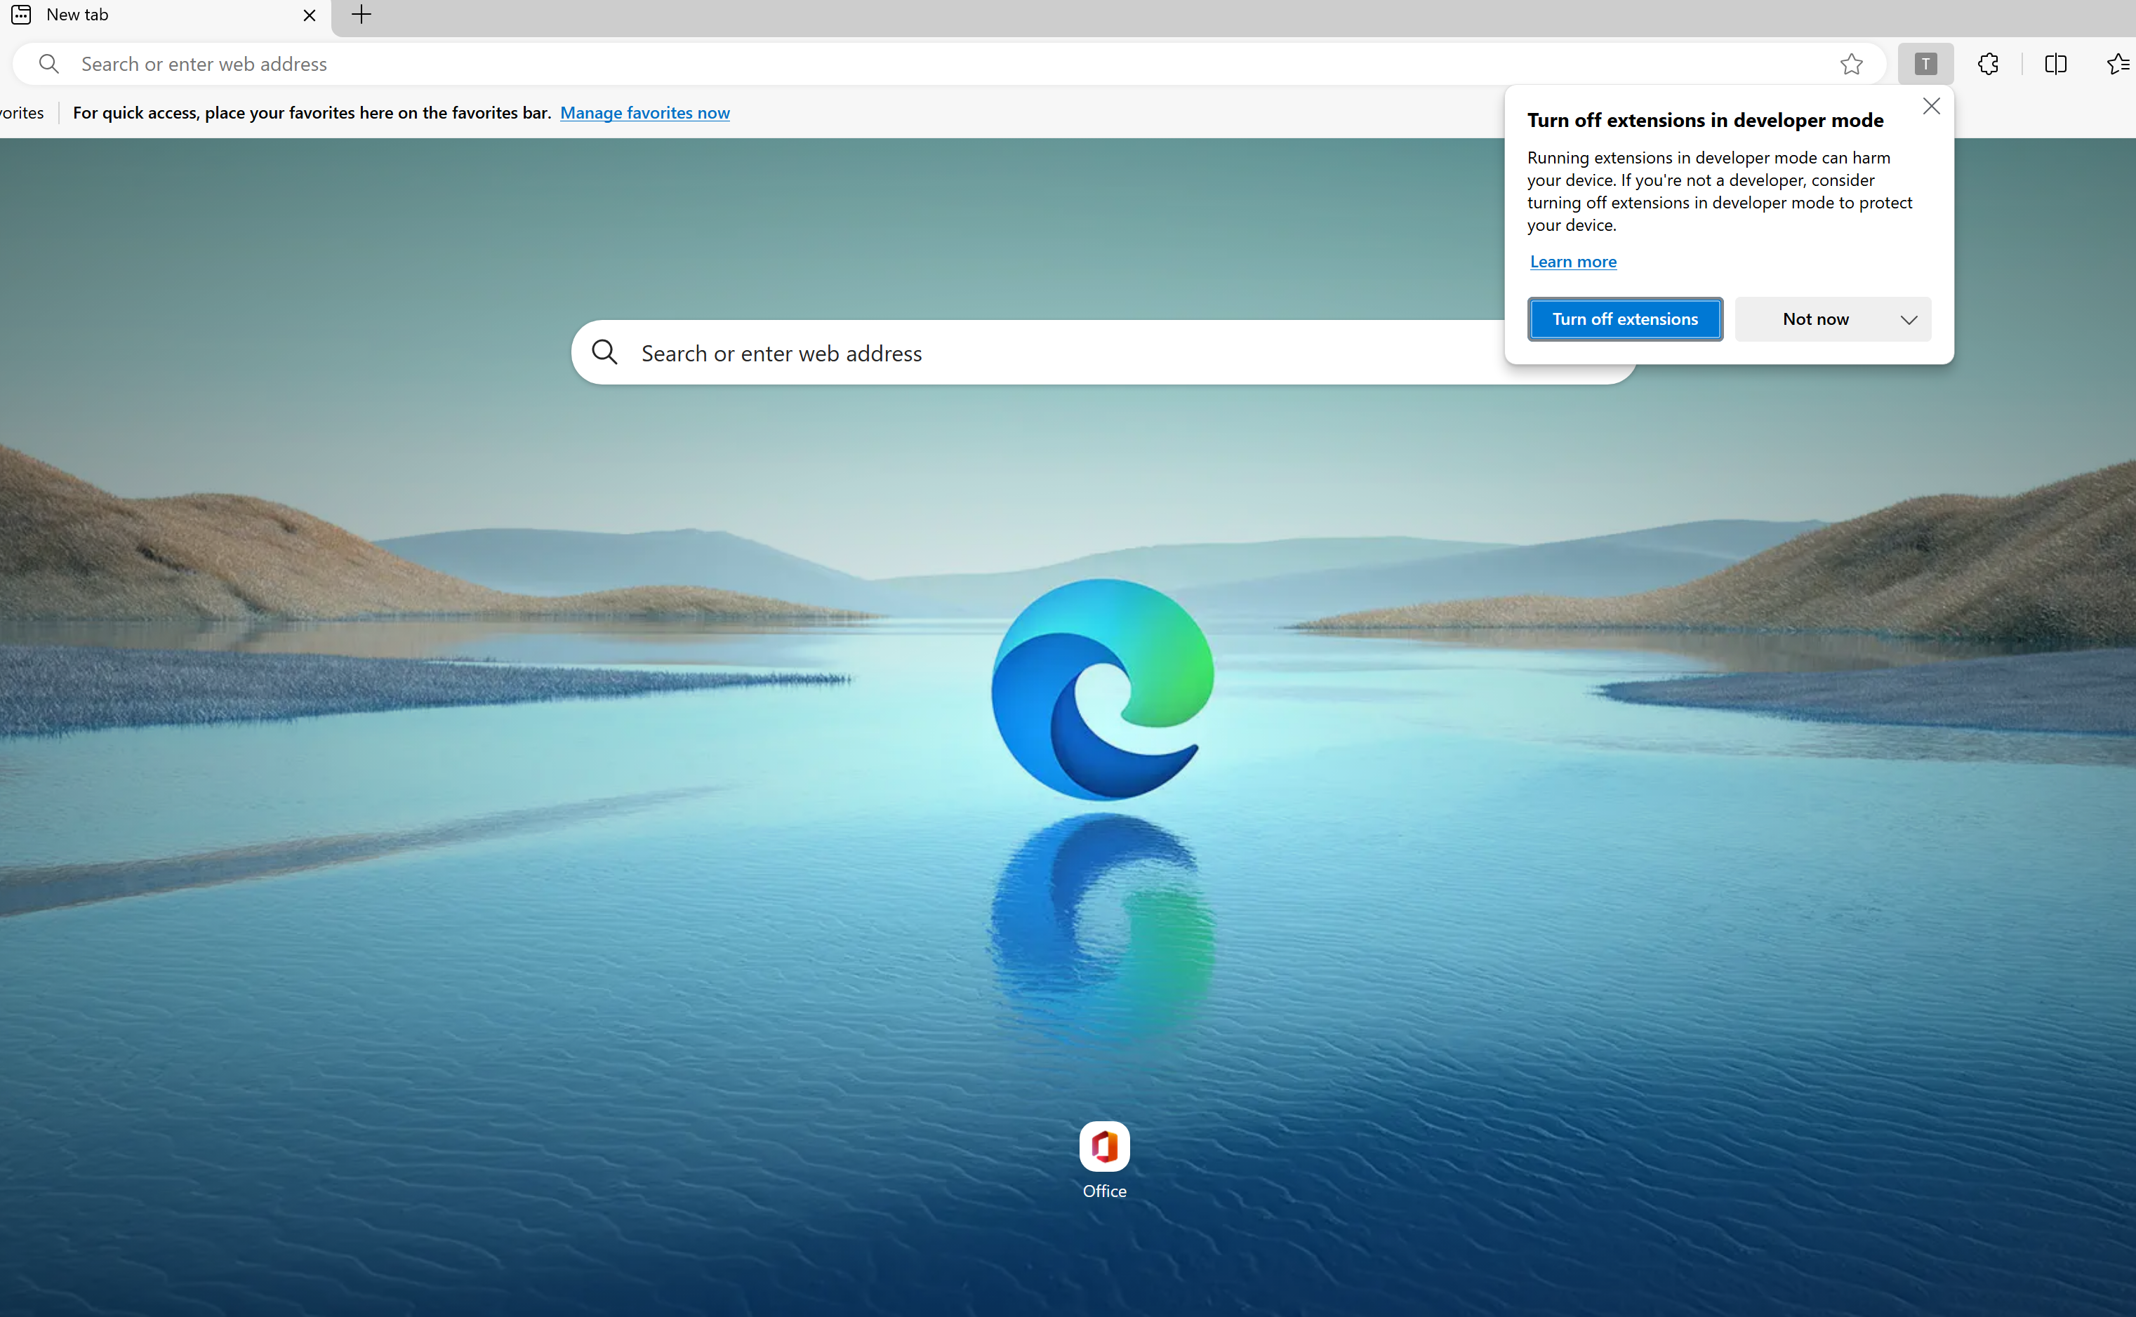

Backdoor existing shortcut files
Most people use shortcut files to access common apps
Either on Desktop or in their Taskbar or in their Start menu
Taskbar – %APPDATA%\\Microsoft\\Internet Explorer\\Quick Launch\\User Pinned\\TaskBar\\
Start menu - %APPDATA%\\Microsoft\\Windows\\Start Menu\\Programs\\
Chromium browsers have a commandline argument to load unpacked extensions
Just add "—load-extension=" to the end of an existing shortcut
Pretty stealthy
On edge there will be a warning about extensions, but it doesn’t stop anything
Can be blocked by group policy
Only works on Chromium-based browsers

Slide 29

Enumerate installed extensions
If stuff already exists, why not use it?
We can create manifests if NativeMessaging is supported but not used
Or overwrite them if they already exist
You’ll need to recover the extension name
The stealthiest and cleanest method
Not every extension supports it though
Can set us up for some further offensive steps…

Slide 30
III. Does this functionality expose any other attack surface?

Slide 31

Other attack surface?
Yes, it does
There are multiple points of failure
And no standard
This usually = misconfigurations
We have the following files which we can target:
NativeMessaging Manifest
NativeMessaging Host application
NativeMessaging registry key (or file on Linux/MacOS)
If any don’t exist or we have permissions over them, we can hijack
This is especially impactful if we know other users have these extensions
We won’t go into it, but you could look for vulnerabilities in the binary

Slide 32

Example
If NativeMessaging manifest is in C:\ProgramData\
We can probably overwrite it
If it is a corporate extension, other users probably have it
Their browsers will likely use the same manifest
This = code exec as other users!
From potentially low privs
The same goes for:
If the registry key is misconfigured and writeable
If the NativeMessaging host application (or DLL’s) are misconfigured and writeable

Slide 33
5. Are the blue team aware?

Slide 34

Are the blue team aware?
Doesn’t seem to be known in Blue circles
Which would make sense
I did find this post by NVISO Labs - (https://blog.nviso.eu/2018/12/21/detecting-suspicious-child-processes-using-ee-outliers-and-elasticsearch/ )
It basically goes over detecting weird child processes
In particular this…

Slide 35
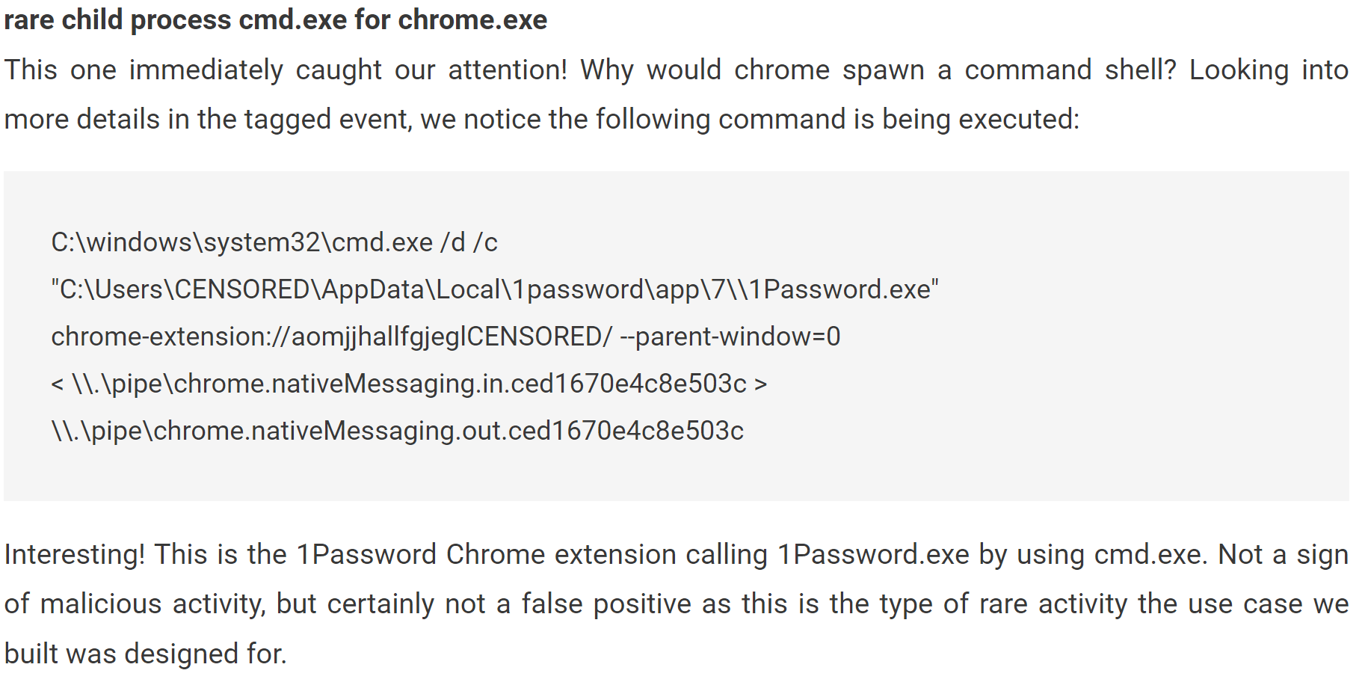
Blue team blog
(All credit to Daan Raman of NVISO Labs)

Slide 36
6. How can you protect yourself?

Slide 37



Defensive considerations? - Mitigations
There are a number of steps you can take:
Apply group policy/registry keys to stop extension loading
https://learn.microsoft.com/en-us/deployedge/microsoft-edge-manage-extensions-policies
https://support.google.com/chrome/a/answer/7532015?hl=en
Ensure NativeMessaging applications, manifests and registry keys are correctly permissioned

Slide 38
Defensive considerations? - Detections
There are a number of steps you can take:
Create alerts for if a registry key is created under NativeMessaging for a browser
Create alerts for if a "ExtensionInstallForcelist" registry key value is created for a browser
Create alerts for if "—load-extension=" is in a commandline
Create alerts as NVISO described in their blog for uncommon child processes

Slide 39
7. Is there an easy way I can test this?

Slide 40

You’re welcome
That may all sound like a lot to do yourself!
We have released a tool to automate this and make testing easier
It has 5 main bits of functionality:
Reconnaissance
Installation
LNK path recovery
LNK backdooring
Persistence
It also contains some example vulnerable extensions
All the documentation and source code can be found:
https://github.com/WithSecureLabs/TheExtendables
(This may change)

Slide 41
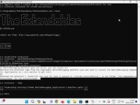
Demo

Slide 42
Summary

Slide 43

Summary
Turns out the extension I was looking at wasn’t malicious!
NativeMessaging can be used for persistence and privesc
You can persist using:
The registry
Backdooring shortcuts
Exploiting existing extensions
You can also exploit this to execute code as another user:
If the backend files/registry keys are incorrectly permissioned
If you exploit the NativeMessaging binary
You can prevent some exploitation with lockdowns of file permissions and GPOs
You can alert on the anomalous telemetry which this technique produces
You can download our tool for a PoC!

Slide 44

That’s all! Any questions?

